Slide 1

Cerivcal caner shape based analysis

Slide 2
Shape Features Selected :
Nucleus Area
Cytoplasm Area
Narea/Carea
Nucleus Perimeter
Cytoplasm Perimeter
Major axis(Cytoplasm , Nucleus)
Minor axis(Cytoplasm , Nucleus)
Kernal Elongation
Cytoplasm Elongation
Kernal Roundness
Cytoplasm Roundness

Slide 3
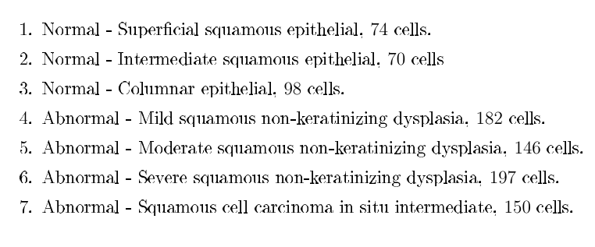

Slide 4
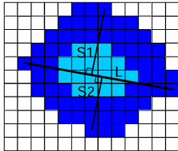
Nucleus area(1) and Cytoplasm area(2): Calculated by counting the corresponding pixels of the segmented picture. A pixels area is (0201 m)2
N/C ratio(3): Tells how small the nucleus area is compared to the area of the cytoplasm. It is given by:
N C = Nuclarea/ Nuclarea+Cytoarea

Slide 5
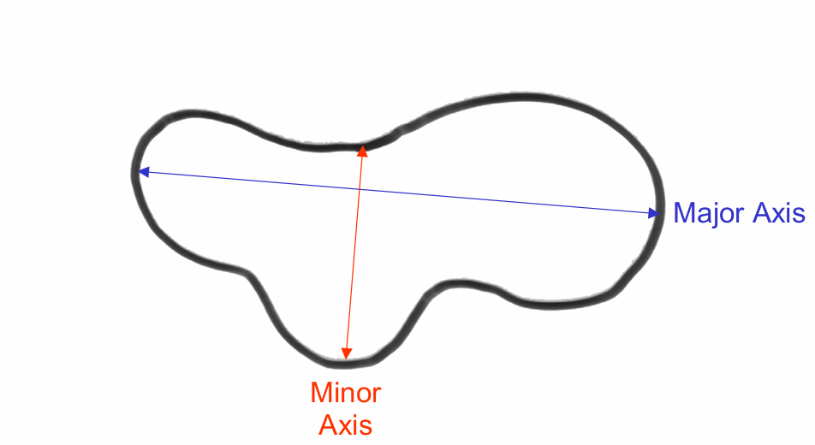
The major axis is the (x,y) endpoints of the longest line that can be drawn through the object.
The minor axis is the (x,y) endpoints of the longest line that can be drawn through the object whilst remaining perpendicular with the major-axis

Slide 6
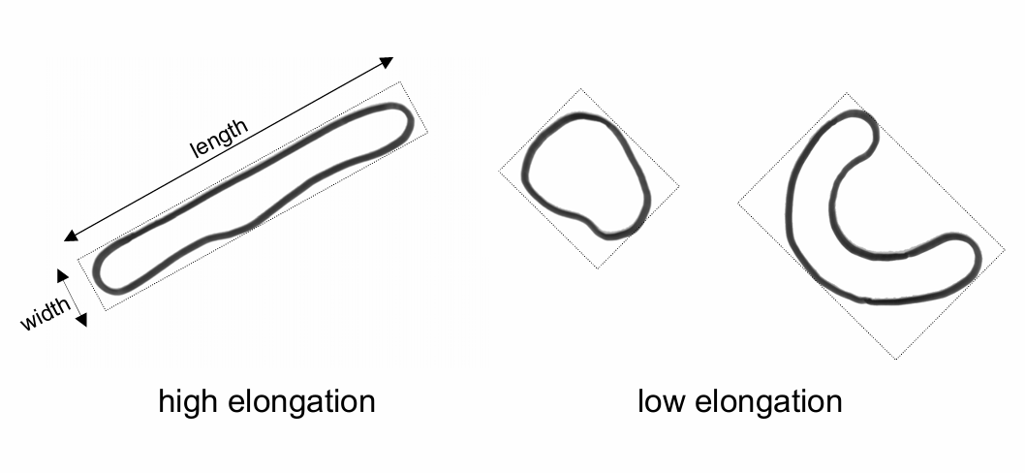
Nucleus(8) and Cytoplasm(12) elongation: The elongation is calculated as the ratio between the
shortest diameter and the longest diameter of the object.
N elong = Nshort/Nlong
C elong = Cshort/ Clong
If the ratio is equal to 1, the object is roughly square or circularly shaped. As the ratio decreases from 1, the object becomes more elongated

Slide 7
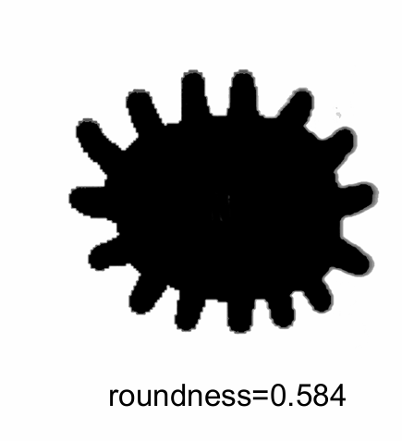
Nucleus(9) and Cytoplasm(13) roundness: The roundness is calculated as the ratio between the actual area and the area bound by the circle given by the longest diameter of the object. They are here named Nroundness and Croundness respectively:
Nroundness = Narea/Ncircle
Croundness = Carea /Ccircle
This statistic equals 1 for a circular object and less than 1 for an object that departs from circularity, except that it is relatively insensitive to irregular boundaries

Slide 8
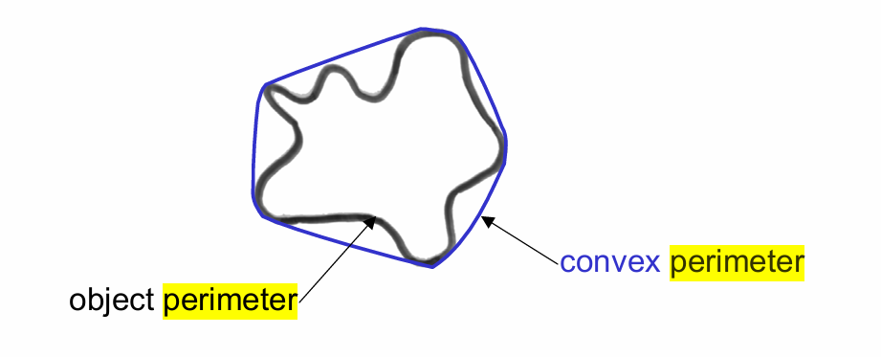
The perimeter [length] is the number of pixels in the boundary of the object

Slide 9
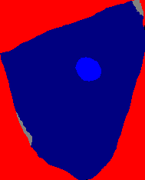
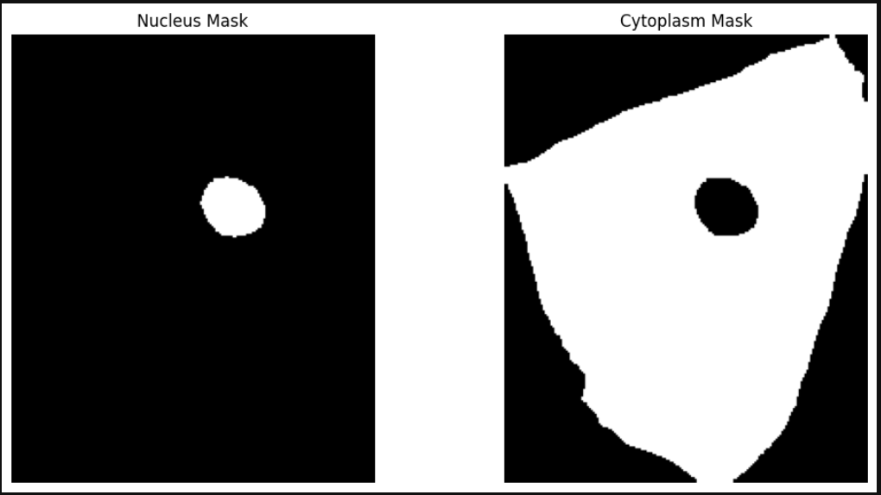
Nucleus rgb code(0,0,255)
Cytoplasm rgb code(0,0,128)

Slide 10
properties[f"{region_type} Area"] = region.area //area
properties[f"{region_type} Perimeter"] = region.perimeter //perimeter
properties[f"{region_type} Major Axis Length"] = region.major_axis_length //major axis
properties[f"{region_type} Minor Axis Length"] = region.minor_axis_length //minor axis
properties[f"{region_type} Elongation"] = region.minor_axis_length / region.major_axis_length //elongation
if region.major_axis_length > 0: # Assuming major_axis_length is the longest diameter //roundness
circle_area = (np.pi / 4) * (region.major_axis_length ** 2)
roundness = region.area / circle_area
else: roundness = np.nan # Handle division by zero
properties[f"{region_type} Roundness"] = roundness

Slide 11
Nucleus/Cytoplasm Area Ratio: 0.028738939644629882
Nucleus Area: 799.0
Nucleus Perimeter: 106.91168824543142
Nucleus Major Axis Length: 34.78541072320451
Nucleus Minor Axis Length: 29.3104586670345
Nucleus Elongation: 0.842607807631324
Nucleus Roundness: 0.840741773995951
Cytoplasm Area: 27802.0
Cytoplasm Perimeter: 825.1097397793778
Cytoplasm Major Axis Length: 228.6054630456633
Cytoplasm Minor Axis Length: 173.5580466435944
Cytoplasm Elongation: 0.7592034080520931
Cytoplasm Roundness: 0.67734970869723

Slide 12
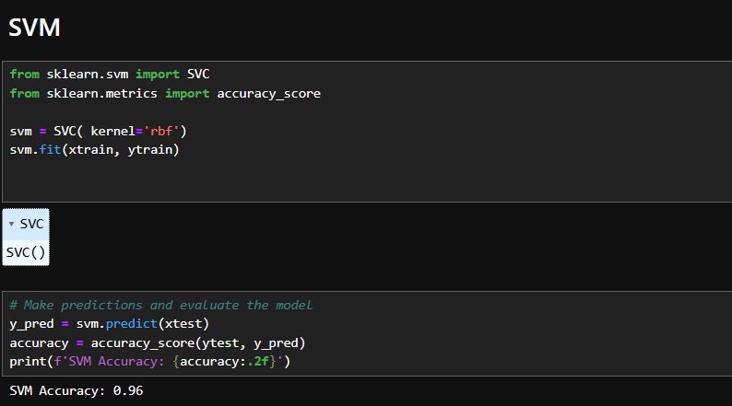
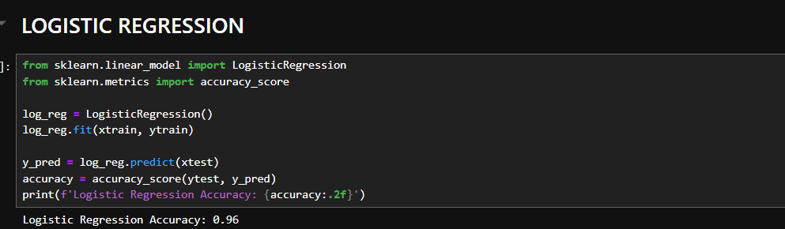

Slide 13
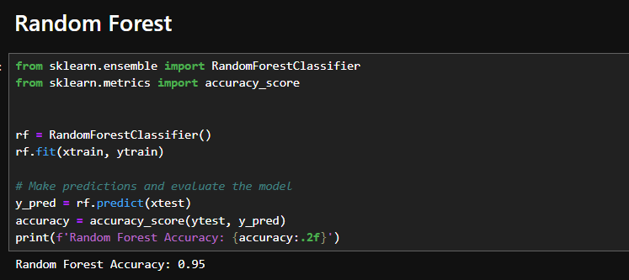
ANN Accuracy: 0.94

